Slide 1
E-Business and E-Commerce
Session 3b

Slide 2
Learning outcomes
You should be able to:
Define the meaning and scope of e-business and e-commerce (last session)
Summarize the main reasons for adopting e-commerce and e-business and which barriers you might encounter (last session)
Identify some of the main business models (last session)
Outline the hardware and software technologies used to build an e-business infrastructure within an organization (this session)

Slide 3
Network components
Internet service provider (ISP)
A provider providing home or business users with a connection to access the internet.
Backbones
High speed communication links used to enable internet communications across a country and internationally
Hosting provider
A service provider that manages the server used to host an organisation website and its connection to the internet backbones.
Web browser
A web browser (commonly referred to as a browser) is a software application for retrieving, presenting and traversing information resources on the World Wide Web

Slide 4
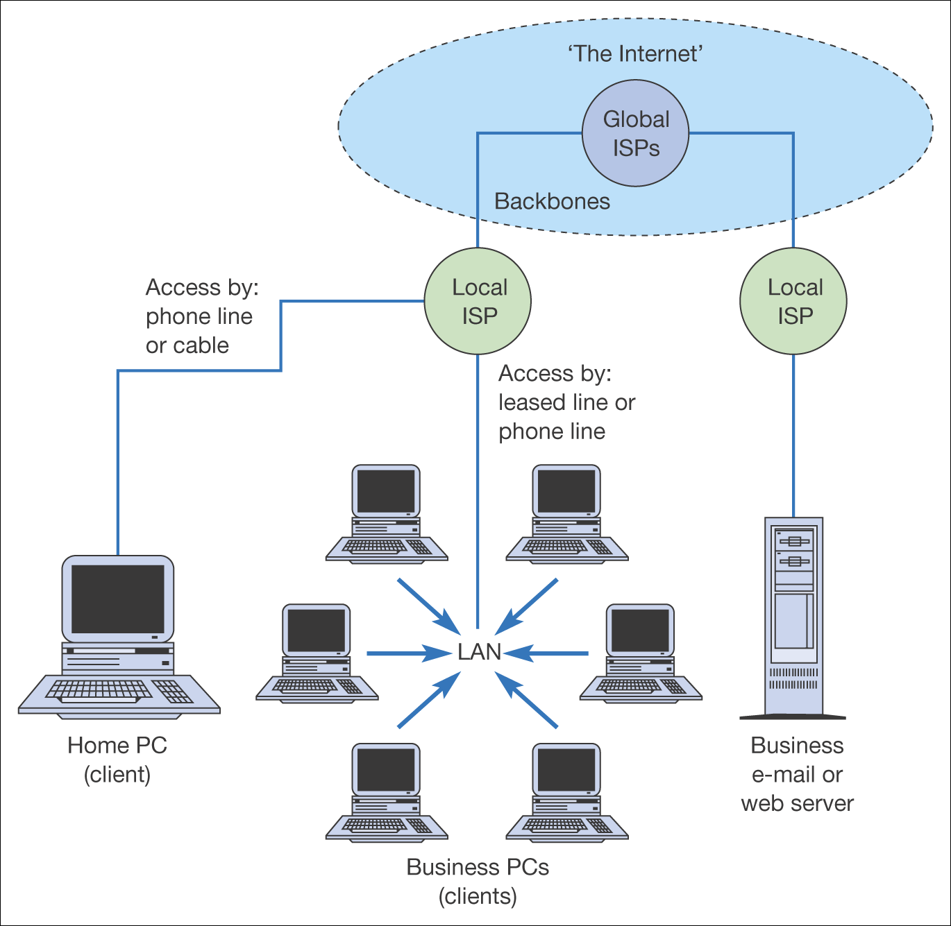
Internet infrastructure components

Slide 5
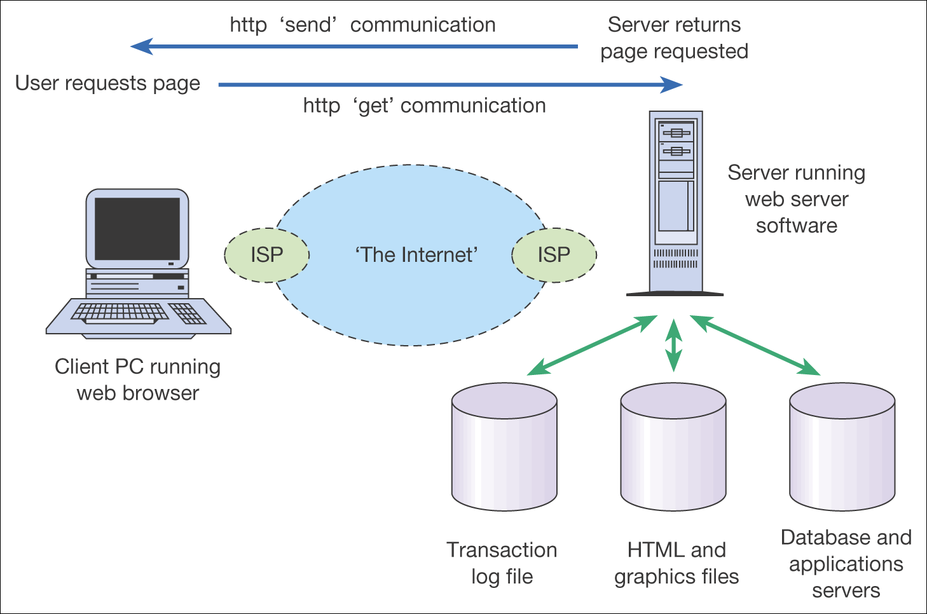
Information exchange between a web browser and web server

Slide 6
Exercise - web
Please list different CMS systems (at least one which supports Microsoft .Net)
Which technical skills are needed to develop (not just enter data) a web page using one of these CMS systems (E.g. HTML, CSS, Razor, JavaScript, XSLT, XML, …)
Please create a company webpage (HTML) stored on your local computer with at least three pages linking to each other (see www.w3schools.com if inspiration is needed). Use a simple editor e.g. Notepad or Notepad++.

Slide 7
Exercise - web
Is your web page shown exactly the same way in each web browser (check if you have installed more than one web browser)?
If they are different, please try to figure out why.
What is the World Wide Web Consortium (www.w3.org )?
Use http://validator.w3.org/ to check if your newly created front page is valid HTML

Slide 8
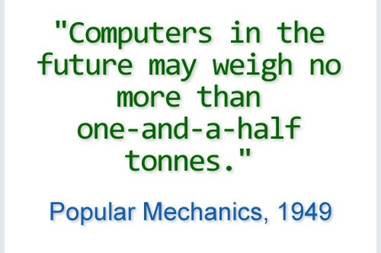
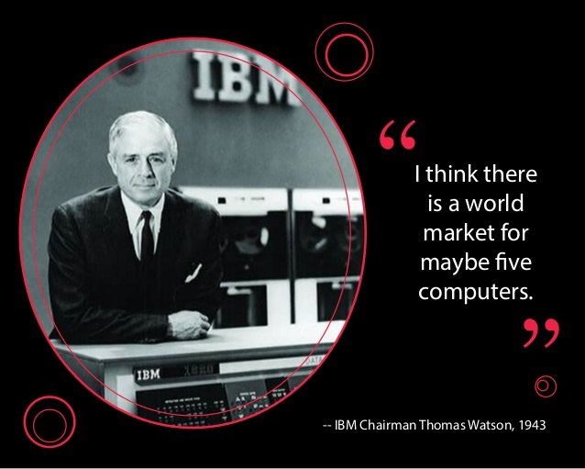
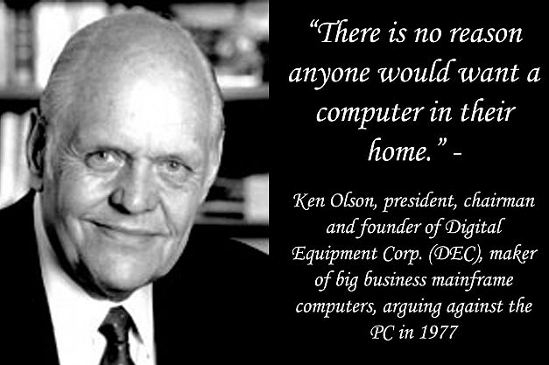
History of the Internet

Slide 9
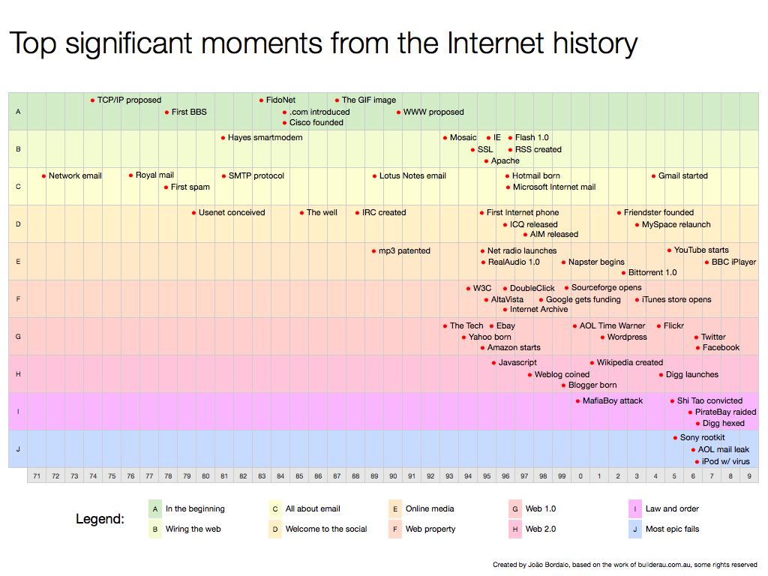
History of the Internet

Slide 10
Network
Content Management System (CMS)
Software used to manage creation, edition and review of web based content
Middleware
Software used to facilitate communication between business applications (how to make JAVA communicate Microsoft SQL?)
Firewall
A specialized software application mounted on a server at the point where the company is connected to the internet. Its purpose is to prevent unauthorized access into the company from outsiders.
Demilitarized Zone (DMZ)
is a physical or logical sub-network that contains and exposes an organizations external-facing services to a larger and untrusted network, usually the Internet. The purpose of a DMZ is to add an additional layer of security to an organization's local area network (LAN)

Slide 11
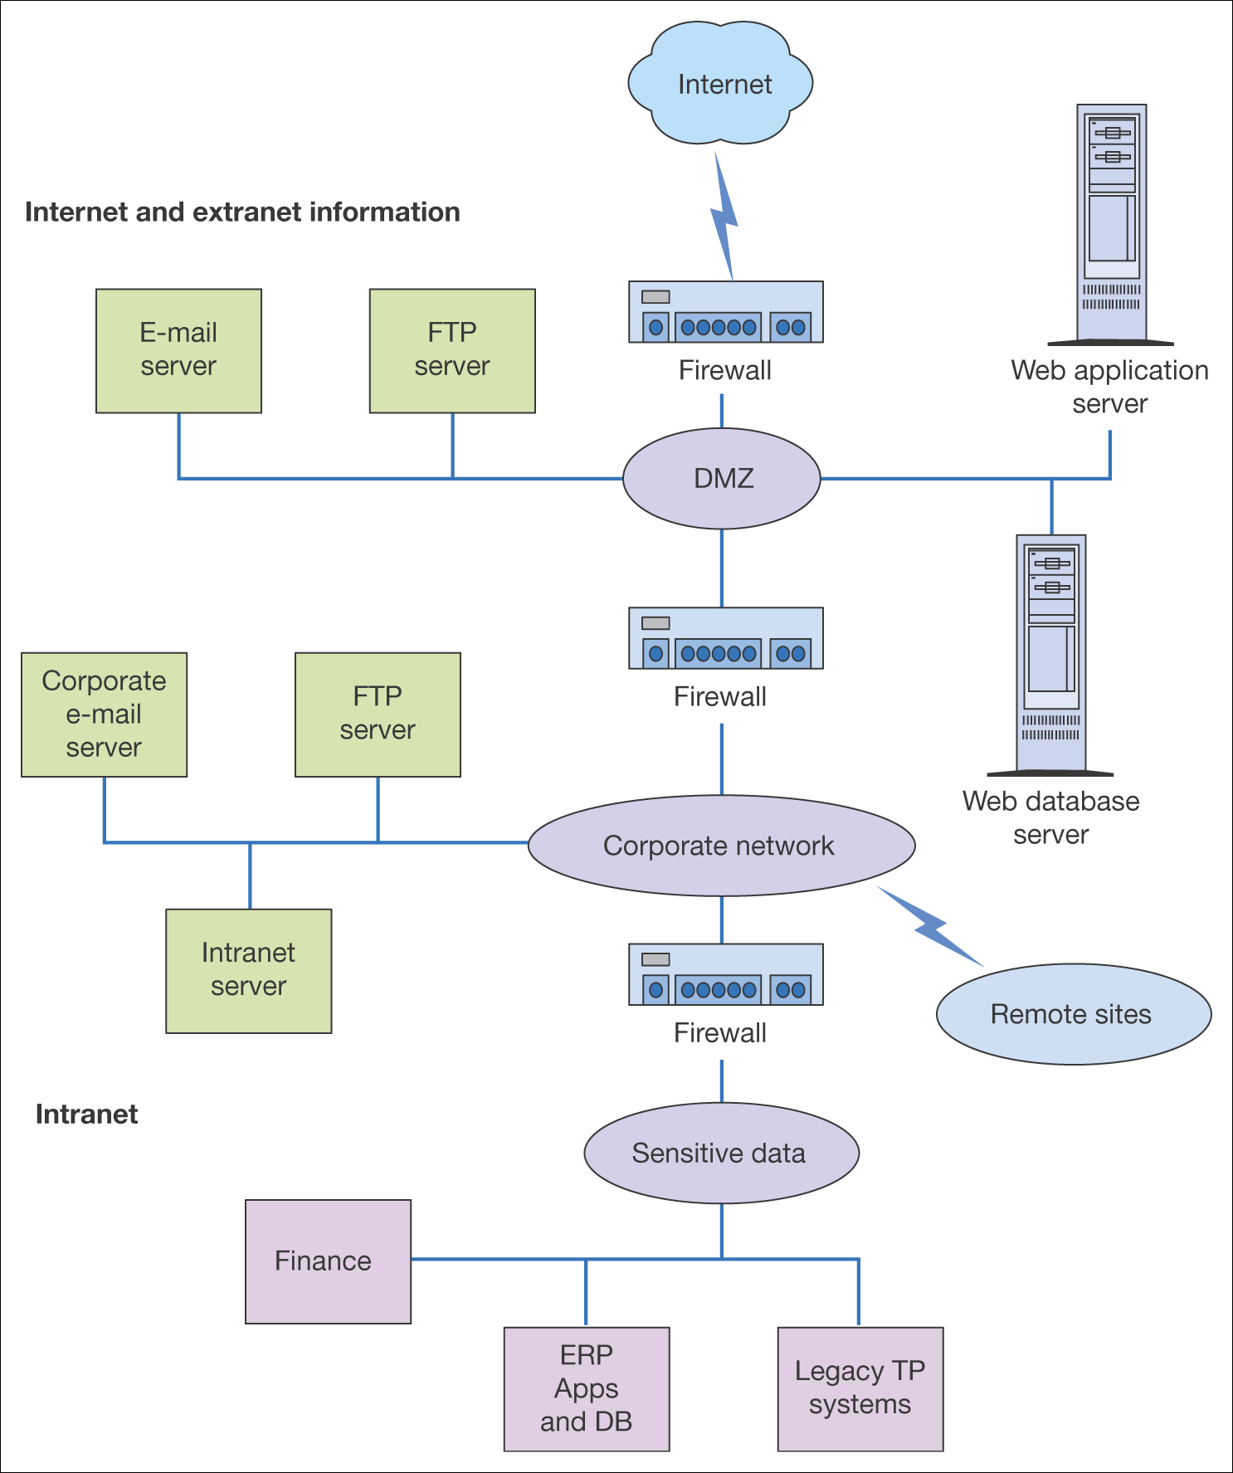
Firewall positions within the e-business infrastructure of the B2B company

Slide 12
URLs and domain names
Web addresses are structured in a standard way as follows:
http://www.domain-name.extension/filename.html
Please find out what some of the different domain name extensions mean
.eu
.com
.co.uk, .uk.com
.org or .org.uk
.gov
.edu, .ac.uk
.int
.net
.biz
.info

Slide 13
Web technologies
Hyperlink
A method of linking web pages
HTML example: <a href=“http://www.google.com”>My google link</a>
Browser plug-in
An add-on program to a web browser providing extra functionality
Web servers
Stores and present the web pages accessed by web browsers
Cascading Style Sheets (CSS)
Enable web designers to define standard styles (e.g. fonts and colors) to hypertext markup language documents (HTML)
Static Web Page
A page on the web server that is invariant
A dynamically created web page
A page that is created in real time, often with reference to a database query

Slide 14
Web technologies
Web application framework
A standard programming framework based on reusable library functions for creating websites
Transaction log files
A web server file that records all page requests
Web analytics system
Information on visitor volumes, sources and pages visited are analyzed through web analytics systems
Browser compatibility
Cross-browser compatibility is the capability of a site to render and deliver interactivity correctly in different versions of web browsers (e.g. Firefox, IE, Chrome)

Slide 15
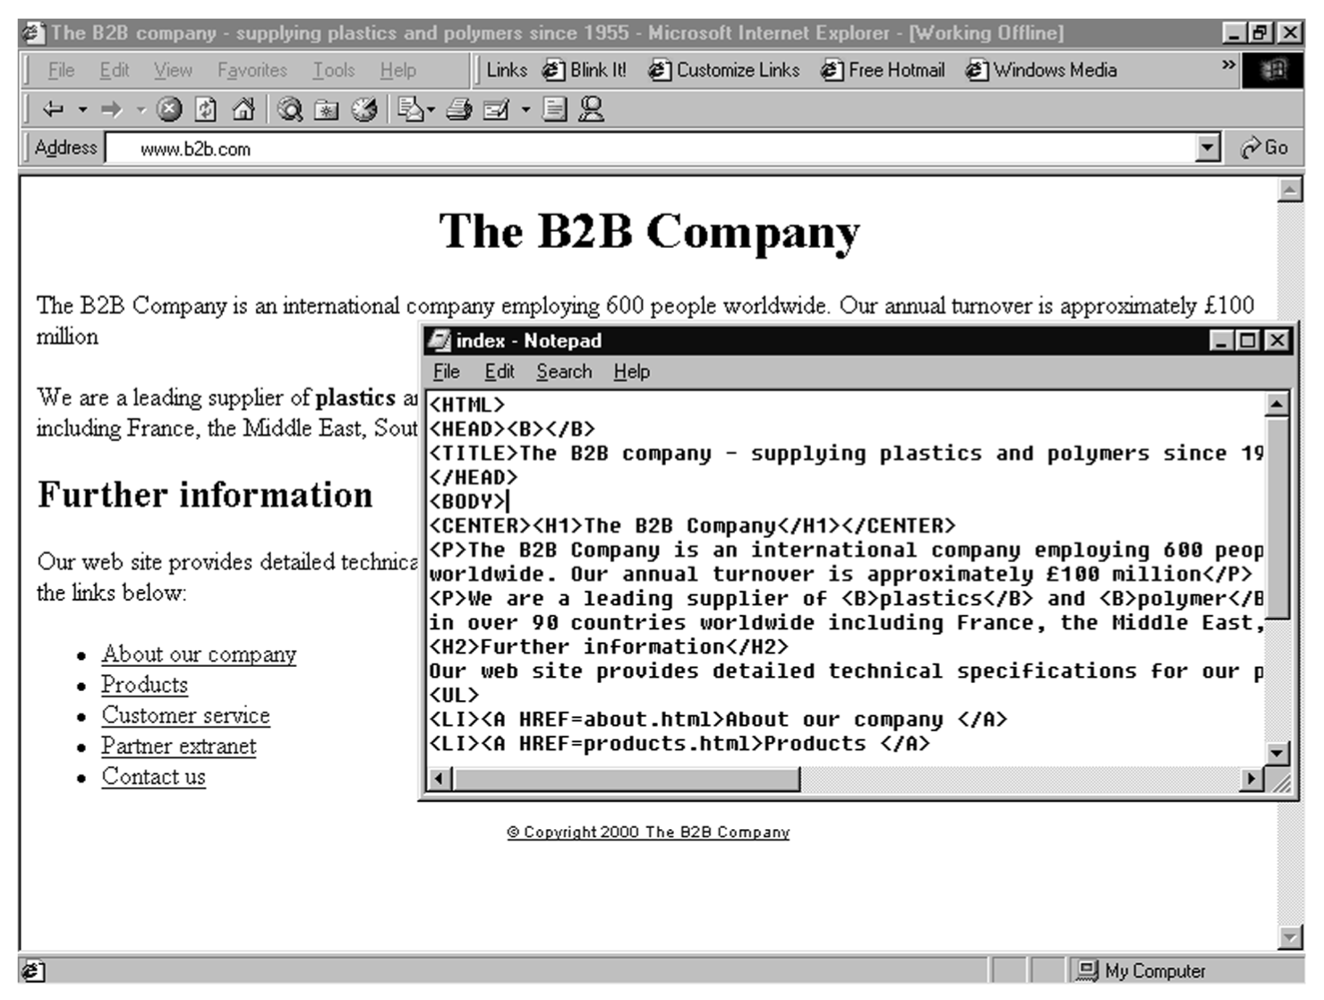
HTML Example
Figure 3.10 Home page index.html for The B2B Company in a web browser showing HTML source in text editor

Slide 16
XML example
<bookstore> <book category="CHILDREN"> <title>Harry Potter</title> <author>J K. Rowling</author> <year>2005</year> <price>29.99</price> </book> <book category="WEB"> <title>Learning XML</title> <author>Erik T. Ray</author> <year>2003</year> <price>39.95</price> </book>
</bookstore>

Slide 17
Exercise - web technologies
Please list at least one Linux and one Microsoft web server
Is Internet Information Service (IIS) installed on your Microsoft PC?
Please create a XML file showing a CD catalog. It should contain three different CDs with the name of the CD, publisher, year and author. Add the songs for each CD as elements.
Please add a CSS to your web page in the head section and use it to format the page (e.g. change font and background color).
<link rel="stylesheet" type="text/css" href="styles.css" />

Slide 18
Please investigate the following concepts
Blogs
Feeds (RSS)
IP-address (IPv4 and IPv6)
IPTV
Peer-to-peer
TCP/IP
Widgets
VOIP
SOA (service-oriented architecture)

Slide 19
Exercise
What is the difference between JavaScript and Java?
Implement Wilson’s formula on your company website using JavaScript and HTML
Annual demand:<br>
<input type="text" id="annDemand">
<button onclick="displayOOS()">Calculate</button>
……
function displayOOS() {
var d = document.getElementById("annDemand").value;
…..
}

Slide 20
1st year project
Go through the ideas in ”Suggested contents” and write down what to include in your project (All parts are not relevant for all projects!).
Consider how you can use todays subjects in your project
Create a “table of contents” for your project
Start the preliminary investigation in relation to your project
Project plan
…

